Slide 1
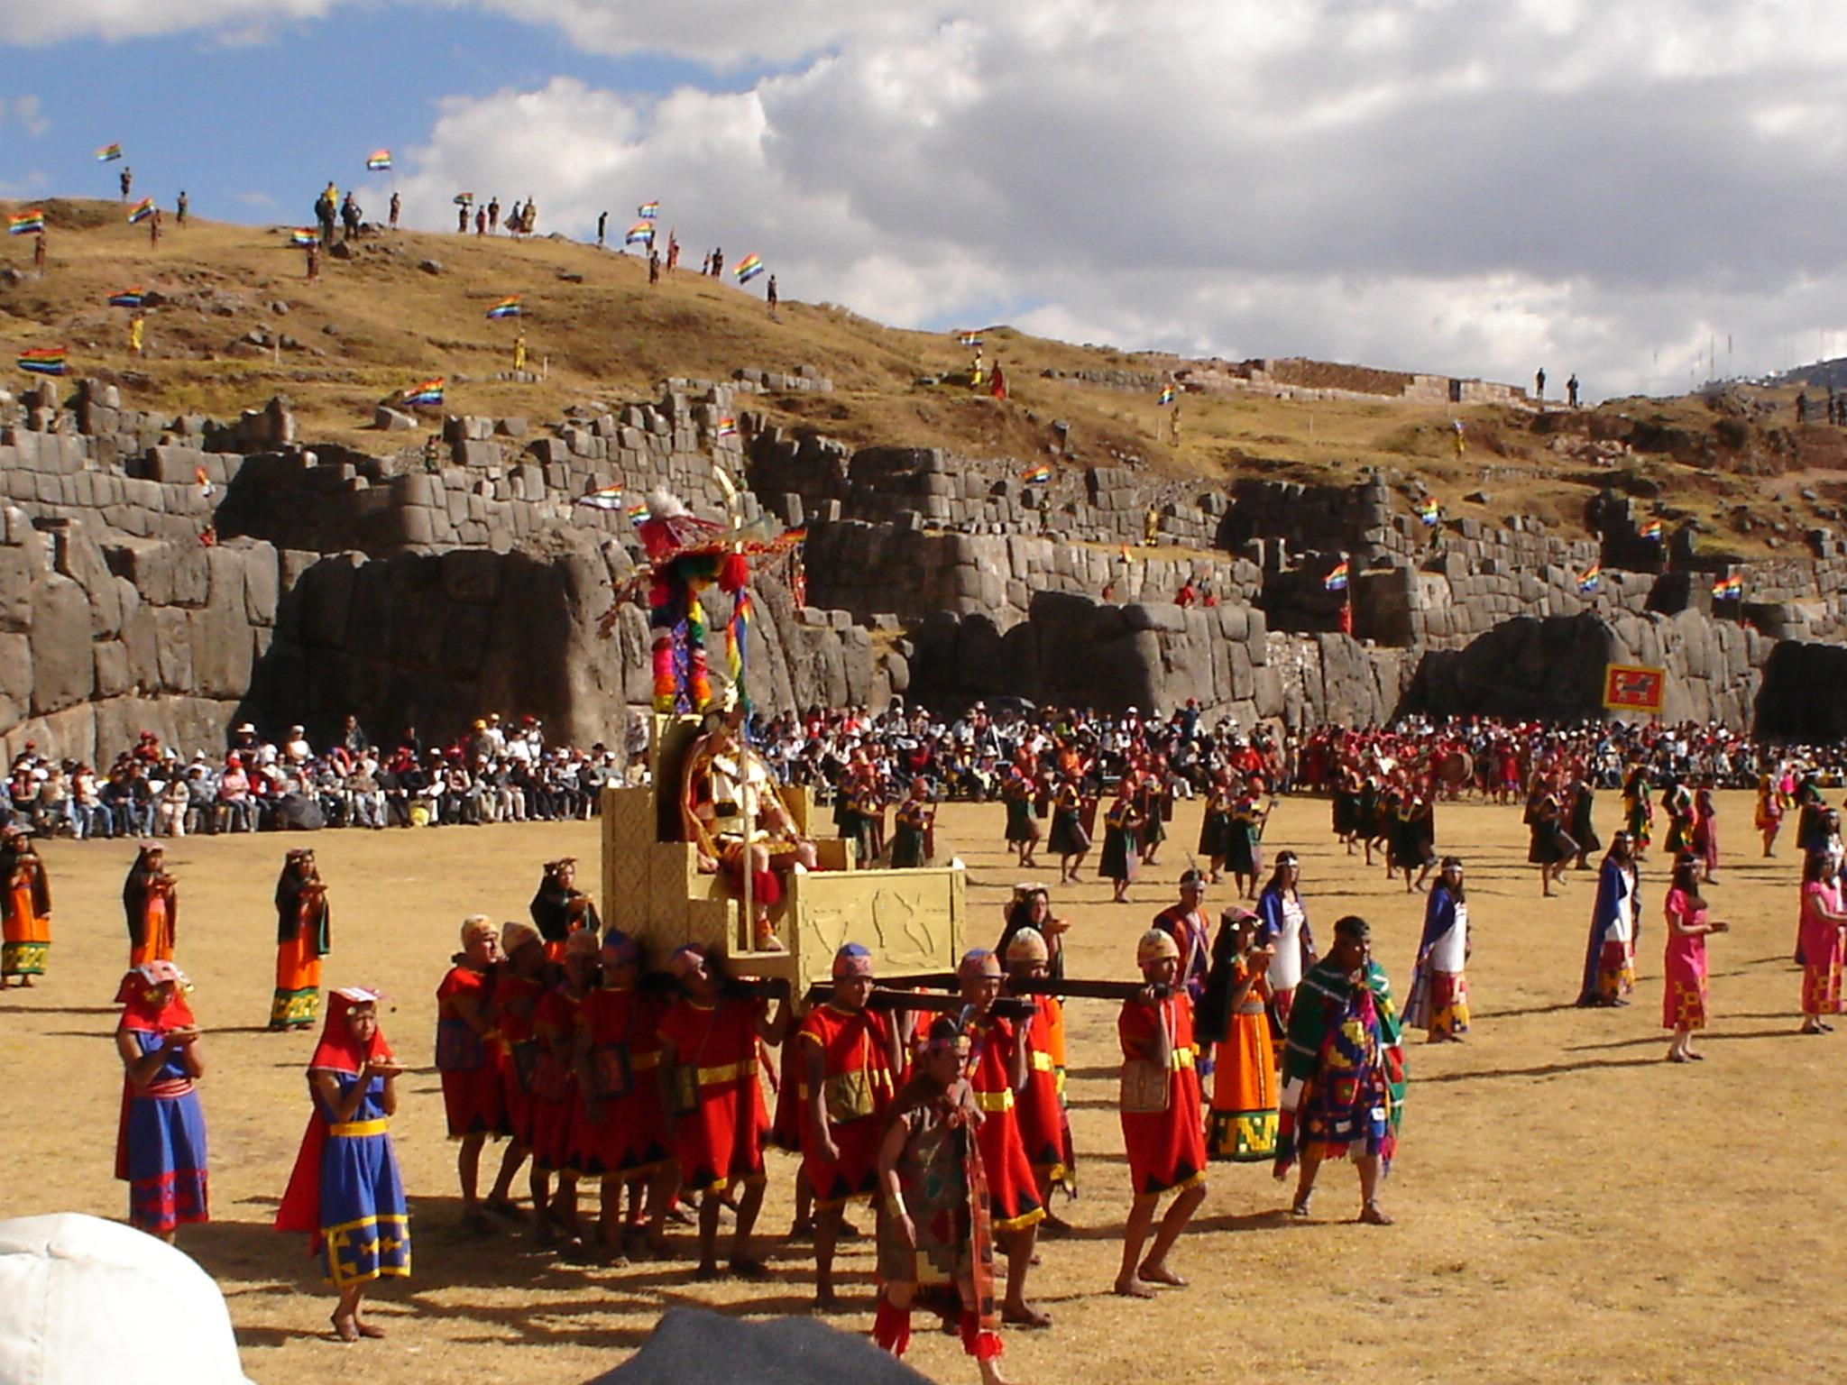
THE INTI RAYMI FESTIVAL

Slide 2

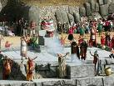
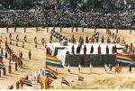

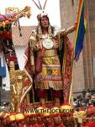
The actors celebrate by honoring the Sun God, thanking for good crops and giving homage to the Inca as son of the Sun
It is celebrated on July 24th and takes place in Sacsayhuaman – Cusco.
Many people from our county and from other countries go to enjoy the ceremony
it is famous because of the majesty and religiousness in honor to the Sun God.
THE INTI RAYMI FESTIVAL

Slide 3

A PIECE OF ADVICE FOR SIGHTSEERS
Should make a hotel reservation a week in advance.
Keep the city clean, don’t litter

