Slide 1
Listen to the song: DISCO.

Slide 2

DISCUSSION
Students discuss the following questions:
1.what words or expressions impacted you ?
2. What expressions are identified with your personality ?

Slide 3

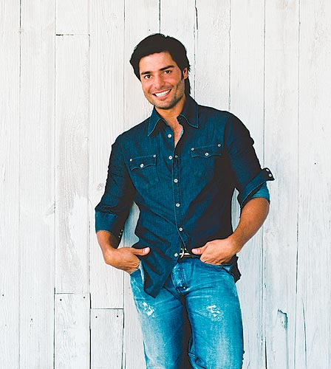
TOPIC : Adjectives to describe personality trials.

Slide 4
OBJECTIVE
By the end of the session students will be able to use adjectives to describe personality trails.

Slide 5

WORKSHEET
Listen to the song again and complete the gaps.
She is D _________________
She is I _________________
She is S _________________
She is C _________________
She is O oh, oh
She is D _________________
She is I _________________
She is S _________________
She is C _________________
She is O oh, oh
She is D _________________
She is I _________________
She is S _________________
She is C _________________
She is O oh, oh
She is D _________________
She is I _________________
She is S _________________
She is C _________________
She is O oh, oh

Slide 6
APPLICATION
Describe a character you admire.
The students read their descriptions and the rest of them guess who is the character.

Slide 7

Thank you !

