Slide 1
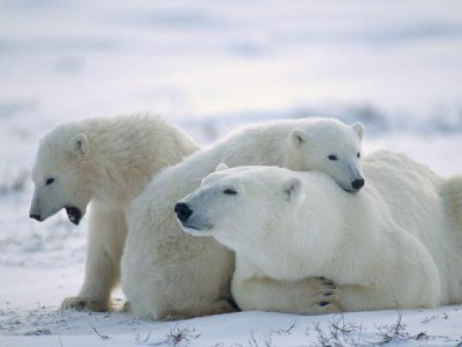
Endangered animals

Slide 2
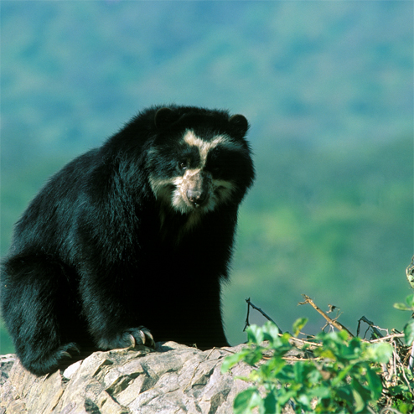
ANDEAN BEAR
DESCRIPTION:
TALL: About 1.30–1.90 mts
WEIGHT: About 80–125 kg
COLOR: Black or brown
HABITAT: In the Andean forests
FOOD: Plant bulbs
Reducing their habitat by agricultural expansion
Have between 2000 and 25000 bears

Slide 3
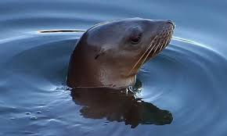
SEA LION
DESCRIPTION:
TALL: About 2.8 mts
WEIGHT: About 300-350 kg
COLOR: Ocher gray
HABITAT: Beaches soft
FOOD: Fish
Insistent game against the sea wolves
We have no more than 1300 lobos

Slide 4
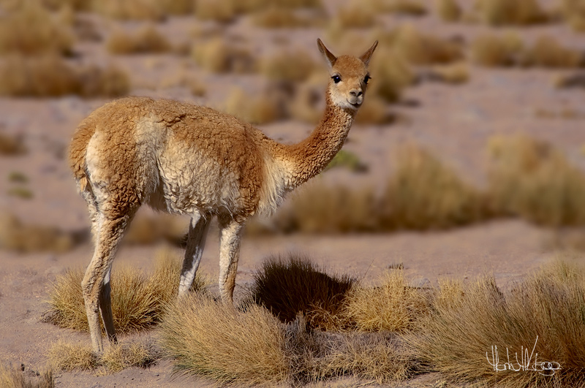
VICUÑA
DESCRIPTION:
TALL: About 80 cm
WEIGHT: About 40-50 kg
COLOR: Tan
HABITAT: Wet lands
FOOD: Pasture
hunting for its extremely soft wool
We have over 140000 vicuñas

Slide 5
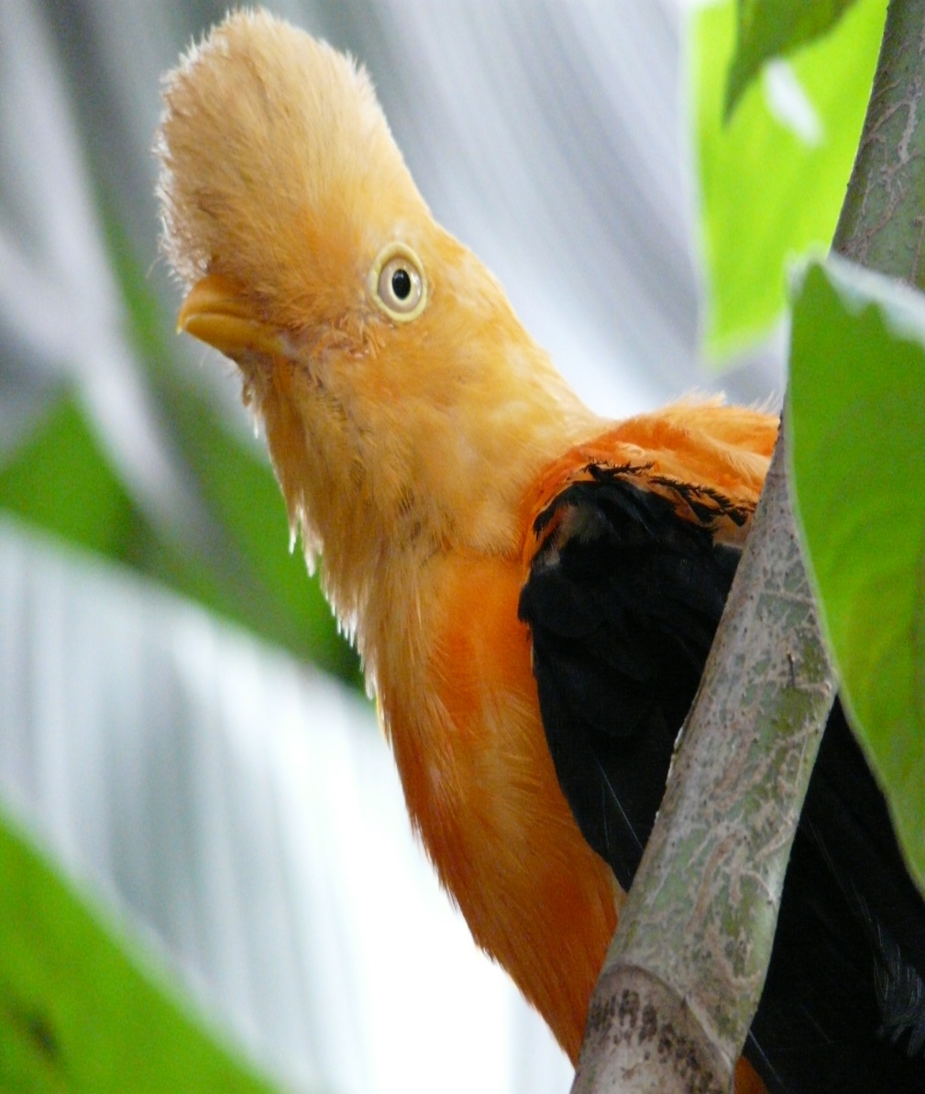
COCK OF THE ROCK
DESCRIPTION:
TALL: About 32 cm
WEIGHT: Varied according to climate
HABITAT: In high humid forests
FOOD: wild fruits
Due to the systematic destruction of their habitat.

Slide 6
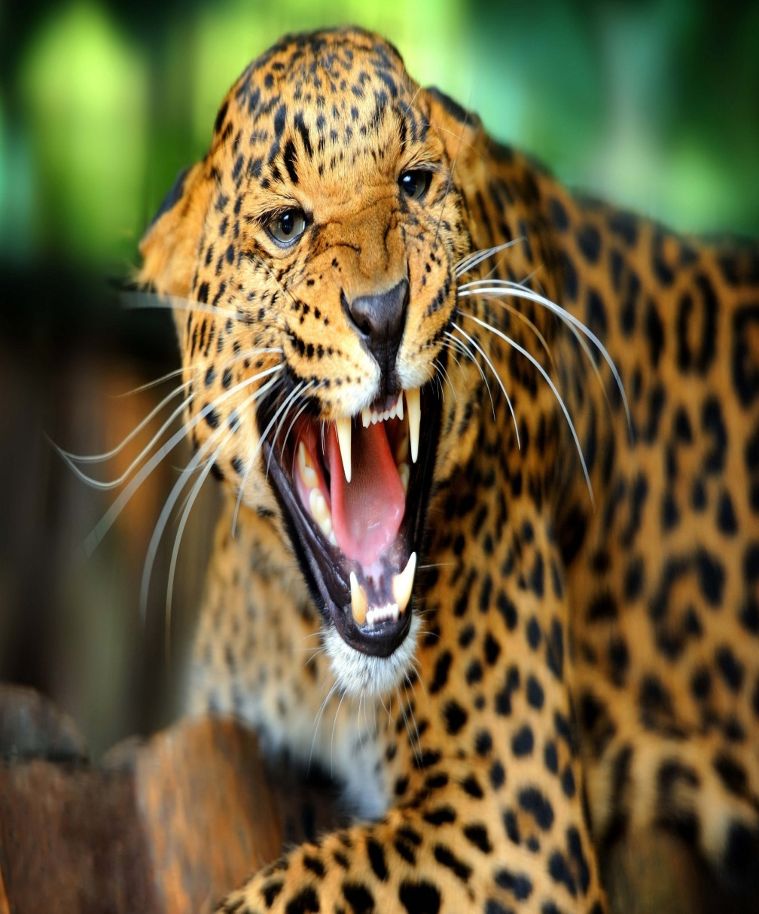
JAGUAR
DESCRIPTION:
TALL: About 1.70 mts long
WEIGHT: About 180 kg
COLOR: Black with red hair pintas
HABITAT: In the forest
FOOD: Turtles, fish
Because poachers
Have between 2000 jaguar

Slide 7
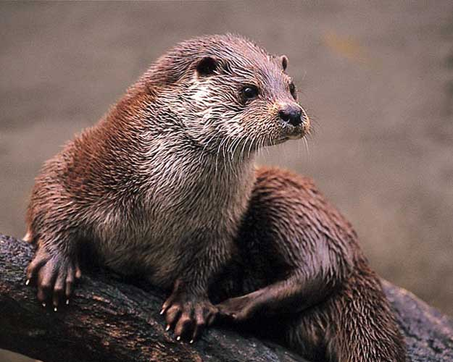
OTTER
DESCRIPTION:
TALL: About 60-65 cm
WEIGHT: About 6-9 kg
COLOR: Brown
HABITAT: On the banks of rivers
FOOD: Fish
River pollution and habitat destruction

Slide 8
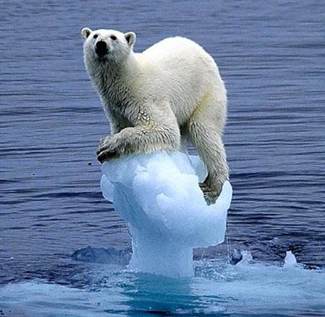
POLAR BEAR
DESCRIPTION:
TALL: About 1.90 -2.60 mts
WEIGHT: About 300-1000 kg
COLOR: White
HABITAT: Canadá-rusia-alaska
FOOD: Seals
the loss of sea ice habitat caused by global warming
there are about 25,000 polar bears

Slide 9
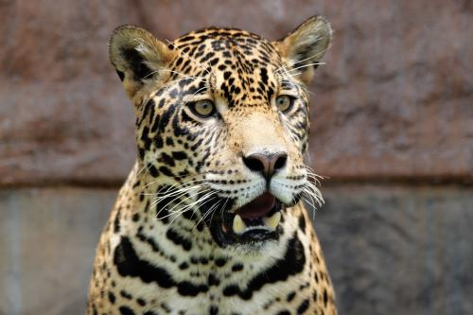
OTORONGO
DESCRIPTION:
TALL: 1.80 mts long
WEIGHT: About 180 kg
COLOR: Brown with black spots
HABITAT: In moist forests
FOOD: Turtles, fish
Habitat loss is a major threat to this cat

Slide 10
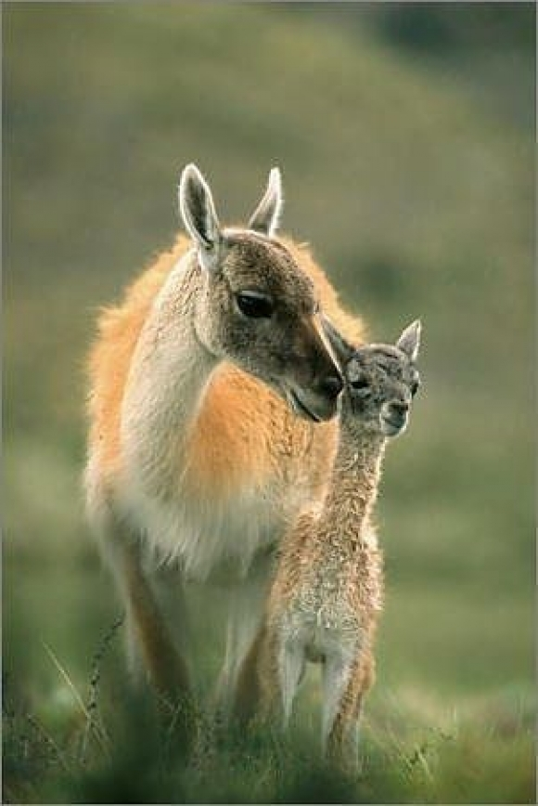
GUANACO
DESCRIPTION:
TALL: About 1.10 mts
WEIGHT: About 100 kg
COLOR: Black or brown
HABITAT: Tropical forests
FOOD: Herbs and tubers
because it has a very fine wool that is of high economic value
There are more than 600000 guanacos

Slide 11
THANK YOU ! ! :3

